Slide 1
CSE 2102: Introduction to Software Engineering
Agile Software Development
Principles of Agile

Slide 2
What is Agile Software Development?
Agile -- readiness for motion, nimbleness, activity, dexterity in motion
  “Jack be nimble, Jack be quick
  Jack jump over the candlestick!”
Agile software development – set of principles or conceptual development framework with characteristics:
  Requirements and solutions evolve
  Cross-functional teams – working in all functions
  Adaptive planning – changing business environment
  Evolutionary development
  Early delivery – working software as a measure of progress.
  Continuous improvement
  Rapid and flexible response to change

Slide 3
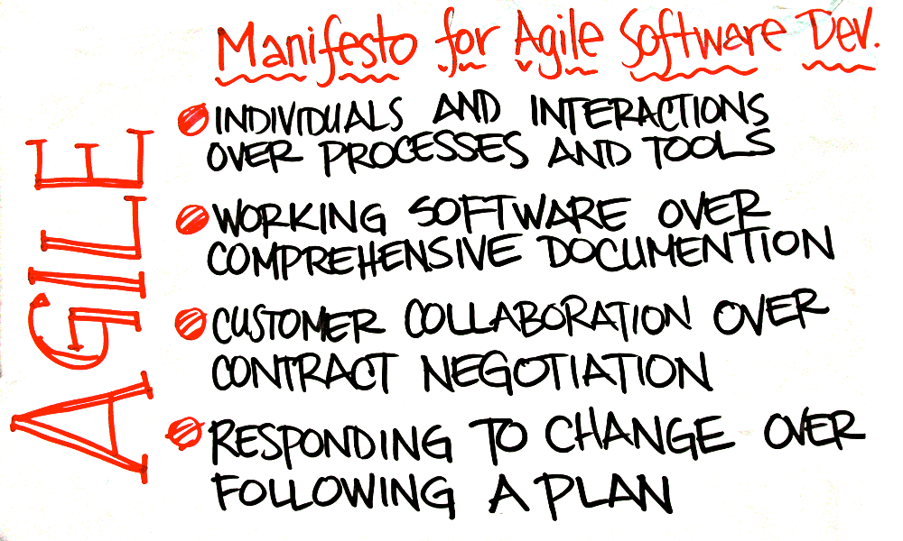
Agile Manifesto
Published in February 2001 – discussion of lightweight development methods
“Uncovering better ways of developing software by doing it and helping others do it”
Chaordic – following the fine line or balance between order and chaos

Slide 4
Evolution of Agile
Heavyweight software development methods:
  Heavily regulated, regimented, micro-managed.
Lightweight software development methods emerged:
  Collectively referred to as “agile methods”
Feburary 2001, developers met to discuss lightweight methods:
  Published agile manifesto
Manifesto based on 12 principles:
  Promote teamwork, collaboration, and process adaptability
Notes:
Time box is a fixed period of time for an activity.

Slide 5
Principles of Agile Manifesto #1
Incremental delivery:
  Deliver early, often continuous
  Break down requirements into small increments to minimize upfront planning and design
  Each iteration or timebox is very short – no more than few weeks.
  More frequent deliveries correlates with higher quality
  Rudimentary first system, add increasing functionality with each iteration
  Cross functional team – planning, analysis, design, coding, unit testing, and acceptance testing.
  Customers specify the functionality for each increment

Slide 6
Principles of Agile Development #2, #3
Working software measures progress, delivered frequently:
  True deliverables are not comprehensive documents or plans
  Err on the side of too little as opposed to too much documentation
  “How much” working software as opposed to the phase, volume of code or documentation

Slide 7
Principles of Agile Development #4
Customer involvement:
  Customers may use delivered systems, or may just review the functionality
  Report on the changes to be made, and provide meaningful feedback
  Frequent interactions between customers, developers, and stakeholders
  Every team should include customer representative – person agreed upon by stakeholders.
  Available to provide feedback to the developers through the iteration.
  Prioritize system requirements to optimize ROI
  Project must be “continuously guided”

Slide 8
Principles of Agile Development #5
  Face-to-face communication and co-location:
    Conversation or talking -- Most efficient method of conveying information
    May create documents, but no attempt to communicate overall project information in writing
    Default is not written specs, written plans, or written plans
    Create written docs only if there’s significant or immediate need
    “Information Radiator” – Large display board that displays project status, that passer bys can see

Slide 9
Principles of Agile Development #6
People not process:
  People most important, all other factors such as environment, process, management, secondary.
  Secondary factors must change if adversely impacting people
  Build a team around motivated individuals
  Recognize and exploit the skills of the development team
  Team members should be left to develop their own ways of working
  No imposing of prescriptive process.

Slide 10
Principles of Agile Development #7
Embrace change:
  Welcome change, even late in the game
  Design the structure to be flexible to accommodate changes
  Harness changes for customer’s competitive advantages
  Object-oriented programming may provide the flexibility to accommodate change.
  Team members do not dread change, they expect it.

Slide 11
Principles of Agile Development #8
Sustainable development:
  Maintain a constant pace idefinitely
  Like a marathon, not a 50-yard dash
  Run fast, but at a pace that can be sustained through the duration of the project.
  Running too fast leads to shortcuts, burnouts and debacles
  Don’t get too tired – avoid the temptation to borrow tomorrow’s energy to get a bit more done today.
  Work only as fast as what allows to maintain quality.

Slide 12
Principles of Agile Development #9
Focus on simplicity:
  Maximize the amount of work not done
  Take simplest path which takes consistently towards goals.
  Don’t plan today for tomorrow’s problems
  Both in the process and the product
  Eliminate complexity, focus on highest quality today.
  Develop confidence that it can change tomorrow, if needed.

Slide 13
Principles of Agile Development #10
Self-organizing teams:
  Produce best architectures, requirements and designs
  Tasks not pre-assigned to team members from outside
  Responsibilities communicated to team as a whole, team decides best way to fulfill them
  Each team member contributes to all aspects of the project
  No one team member is responsible for architecture, or testing, etc.

Slide 14
Principles of Agile Development #11
Focus on quality:
  Keep the software as clean as possible
  Produce the highest quality code now, not pledge to clean it up when they have time
  Do it right the first time
  Use specific tools and techniques – continuous integration, automated unit testing, test-driven development, design patterns, code refactoring etc.

Slide 15
Principles of Agile Development #12
Team reflection:
  Recognize that the environment is continually and inevitably changing
  Reflect, and adjust behavior and adjust strategies, rules, conventions regularly
  Necessary to change with the environment

Slide 16
Agile is Contemporary
Rapid Software Development and Delivery:
  Fast –changing requirement makes it impossible to produce a set of stable software requirements
  Software has to evolve quickly to reflect changing business needs.
Process to support rapid software development and delivery:
  Specification, design and implementation are inter-leaved
  System is developed as a series of versions with stakeholders involved in version evaluation
  User interfaces are often developed using an IDE and graphical toolset.

